Slide 1


Chapter 4 Network Layer:
The Data Plane
A note on the use of these Powerpoint slides:
We’re making these slides freely available to all (faculty, students, readers). They’re in PowerPoint form so you see the animations; and can add, modify, and delete slides (including this one) and slide content to suit your needs. They obviously represent a lot of work on our part. In return for use, we only ask the following:
Computer Networking: A Top Down Approach
If you use these slides (e.g., in a class) that you mention their source (after all, we’d like people to use our book!)
If you post any slides on a www site, that you note that they are adapted from (or perhaps identical to) our slides, and note our copyright of this material.
Thanks and enjoy! JFK/KWR
All material copyright 1996-2016
J.F Kurose and K.W. Ross, All Rights Reserved
7th edition Jim Kurose, Keith Ross Pearson/Addison Wesley April 2016

Slide 2
Chapter 4: outline
4.1 Overview of Network layer
data plane
control plane
4.2 What’s inside a router
4.3 IP: Internet Protocol (v4)
IP Layer services and functions
datagram format
fragmentation
addressing
forwarding
4.4 IPv6
4.5 Internet Control Messaging Protocol (ICMP, ICMPv6)

Slide 3
















Network layer
transport segment from sending to receiving host
on sending side encapsulates segments into datagrams
on receiving side, delivers segments to transport layer
network layer protocols in every host, router
router examines header fields in all IP datagrams passing through it
application
transport
network
data link
physical
network
data link
physical
network
data link
physical
network
data link
physical
network
data link
physical
network
data link
physical
network
data link
physical
network
data link
physical
network
data link
physical
network
data link
physical
application
transport
network
data link
physical
network
data link
physical
network
data link
physical

Slide 4
Two key network-layer functions
network-layer functions:
forwarding: move packets from router’s input to appropriate router output
routing: determine route (router by router) taken by packets from source to destination
routing algorithms
1
3
2

Slide 5
Network layer: data plane, control plane
Data plane
local, per-router function
determines how datagram arriving on router input port is forwarded to router output port
forwarding function
Control plane
network-wide logic
determines how datagram is routed among routers along end-end path from source host to destination host
two control-plane approaches:
traditional routing algorithms: implemented in routers
software-defined networking (SDN): implemented in (remote) servers
values in arriving
packet header
0111
1
3
2

Slide 6

Per-router control plane
Individual routing algorithm components in each and every router interact/exchange information in the control plane
Routing
Algorithm
control
plane
data
plane
values in arriving
packet header
0111
1
3
2

Slide 7
Chapter 4: outline
4.1 Overview of Network layer
data plane
control plane
4.2 What’s inside a router
4.3 IP: Internet Protocol (v4)
IP Layer services and functions
datagram format
fragmentation
addressing
forwarding
4.4 IPv6
4.5 Internet Control Messaging Protocol (ICMP, ICMPv6)

Slide 8
Router architecture overview
high-level view of generic router architecture:
routing, management
control plane (software)
operates in millisecond
time frame
routing
processor
forwarding data plane (hardware) operttes in nanosecond timeframe
high-seed
switching
fabric
router input ports
router output ports

Slide 9
Input port functions
lookup,
forward
queueing
line
termination
link
layer
protocol
(receive)
switch
fabric
physical layer:
bit-level reception
e.g. optical pulses
decentralized switching:
using header field values, lookup output port using forwarding table in input port memory (“match plus action”)
forward based on destination IP address
goal: complete input port processing at ‘line speed’
queueing: if datagrams arrive faster than forwarding rate into switch fabric
data link layer:
frame level reception
e.g., Ethernet

Slide 10
Input port queuing
fabric slower than input ports combined -> queueing may occur at input queues
queueing delay and loss due to input buffer overflow!
Head-of-the-Line (HOL) blocking: queued datagram at front of queue prevents others in queue from moving forward
switch
fabric
switch
fabric
X
output port contention:
only one red datagram can be transferred. lower red packet is blocked
one packet time later: green packet experiences HOL blocking, as it should have been switched now but blocked red switched instead – was ahead

Slide 11
Output ports
This slide in HUGELY important!
datagram
buffer
queueing
switch
fabric
link
layer
protocol
(send)
line
termination
buffering required if switching fabric faster than transmission rate of link
scheduling discipline chooses which, among queued datagrams, should be transmitted
Datagram (packets) can be lost due to congestion, lack of buffers
Priority scheduling – who gets best performance, network neutrality

Slide 12
Output port queueing
Link BW < N link switch fabric capacity
switch
fabric
switch
fabric
at t, red and blue packets move
from input to output in a slot time
one slot time later 1st red packet starting transmission and 2nd packet arrives, 3rd will arrive next slot time - queue will fill up and overflow
buffering when arrival rate via switch exceeds output line speed and/or switch fabric speed
queueing (delay) and loss due to output port buffer overflow!

Slide 13
Scheduling mechanisms
scheduling: choose next packet to send on link
FIFO (first in first out) scheduling: send in order of arrival to queue
real-world example? – join a queue at a bus stop
discard policy: if packet arrives to full queue: who to discard?
tail drop: drop arriving packet
priority: drop/remove on priority basis
random: drop/remove randomly
packet
arrivals
packet
departures
queue
(waiting area)
link
(server)

Slide 14
Scheduling policies: priority
priority scheduling: send highest priority queued packet
multiple classes, with different priorities
class may depend on marking or other header info, e.g. IP source/dest, port numbers, etc.
real world example? – airline boarding
high priority queue
(waiting area)
arrivals
departures
classify
link
(server)
low priority queue
(waiting area)
2
1
3
4
5
arrivals
packet in service
1
3
2
4
5
departures
1
3
2
4
5
2 and 3 arrive while 1 in service
3 jumps ahead of 2 for service

Slide 15
Scheduling policies: still more
Round Robin (RR) scheduling:
multiple classes
cyclically scan class queues, sending one complete packet from each class (if available) – fair queueing
2
queue
(waiting area)
1
3
4
5
arrivals
arrivals
departures
packet in service
1
3
2
4
5
classify
link
(server)
departures
queue
(waiting area)
1
3
3
4
5
2 and 3 arrive while 1 in service
3 gets serviced ahead of 2 as each class gets one serviced each cycle

Slide 16
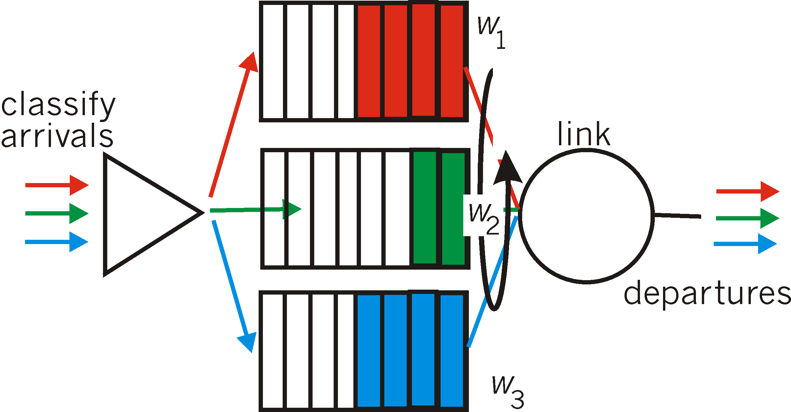
Scheduling policies: still more
Weighted Fair Queuing (WFQ):
weighted Round Robin
each class gets weighted amount of service in each cycle, e.g., each sweep of the queues, red gets 2, green gets 1 and blue gets 3

Slide 17
Chapter 4: outline
4.1 Overview of Network layer
data plane
control plane
4.2 What’s inside a router
4.3 IP: Internet Protocol (v4)
IP Layer services and functions
datagram format
fragmentation
addressing
forwarding
4.4 IPv6
4.5 Internet Control Messaging Protocol (ICMP, ICMPv6)

Slide 18
The IETF network layer
the IETF network layer protocol is called the Internet Protocol (IP)
IP Version 4 (IPv4) is specified in RFC 791 (1981)
IPv6 is new version (initial deployment 2012)
80+% of current Internet traffic is still carried using IPv4
IP henceforth will refer to IPv4 unless IPv6 is explicitly stated
ICMP, IGMP are
Service/helper protocols
related to IP

Slide 19
IP: Waistband of the hourglass
IP is the waistband of the the IETF Internet protocol architecture
only one protocol at the network layer that carries all Internet traffic (control and data) – IP (v4 or v6)
multiple higher-layer protocols
multiple lower-layer protocols
Network Layer: Data Plane 4-19

Slide 20
The Internet network layer
IP is the highest layer protocol implemented in both routers and end devices
Network Layer: Data Plane 4-20

Slide 21
IP Service
delivery service of IP is minimal/simple → robust
IP provide provides an unreliable, connectionless, best effort service (also called: “datagram service”)
unreliable: IP does not make an attempt to recover lost packets
connectionless: each packet (“datagram”) is handled independently. IP is not aware that packets between hosts may be sent in a logical sequence
best effort: IP does not make guarantees on the service (no throughput guarantee, no delay guarantee,…)
consequences - higher layer protocols have to deal with
losses or with duplicate packets
out-of-sequence delivery
Network Layer: Data Plane 4-21

Slide 22
IP Functions
Host:
Router:
routing protocols
path selection
RIP, OSPF, BGP
IP protocol
addressing conventions
datagram format
packet handling conventions
forwarding
table
ICMP protocol
error reporting
router “signaling”

Slide 23
Chapter 4: outline
4.1 Overview of Network layer
data plane
control plane
4.2 What’s inside a router
4.3 IP: Internet Protocol (v4)
IP Layer Services and Functions
datagram format
fragmentation
addressing
forwarding
4.4 IPv6
4.5 Internet Control Messaging Protocol (ICMP, ICMPv6)

Slide 24
IP datagram format
IP protocol version number (4bits)
32 bits
total datagram
length 2¹⁶ (bytes)
header length (4bits)
# of rows of 32bits
(default -no options- 5 rows)
head.
len
type of
service
ver
length
fragment
offset
Fields/bits for
fragmentation/
reassembly
ToS:“type” of service
data needs (8bits)
16-bit identifier
flgs
time to
live
upper
layer
header
checksum
max number
remaining hops (8bits)
(decremented at
each router)
32 bit source IP address
CRC check for
header only
32 bit destination IP address
upper layer protocol
to deliver payload to,
e.g., TCP (6), UDP(17)
options (if any)
e.g. timestamp,
record route
taken, specify
list of routers
to visit (max 40
bytes)
data
(variable length,
typically a TCP
or UDP segment)
Source Address (32bits)
Destination Address (32bits)

Slide 25
Maximum Transmission Unit (MTU)
maximum size of IP datagram is 2¹⁶=65535 bytes, but the data link layer protocol generally imposes a limit that is much smaller
for example:
Ethernet frames have a maximum payload of 1500 bytes→
IP datagrams encapsulated in Ethernet frame cannot be longer than 1500 bytes
the limit on the maximum IP datagram size, imposed by the data link protocol is called the maximum transmission unit (MTU)
examples of MTU sizes for different link protocols:
Ethernet: 1500 SONET: 4470
IEEE 802.3: 1492 MPLS: 1488
Network Layer: Data Plane 4-25

Slide 26

Dilemma – Many Different Links
Internet consists of many different types of links interconnecting all devices
different link types have different link protocols → different MTUs
how does IP know what size to choose for its payload to fit into MTU on every link?
IP also gets segment from transport layer, no control over segment size
Fragmentation

Slide 27
Chapter 4: outline
4.1 Overview of Network layer
data plane
control plane
4.2 What’s inside a router
4.3 IP: Internet Protocol (v4)
IP Layer Services and Functions
datagram format
fragmentation
addressing
Forwarding
4.4 IPv6
4.5 Internet Control Messaging Protocol (ICMP, ICMPv6)

Slide 28

IP fragmentation, reassembly
IP’s MTU mismatch solution
divide (“fragment”) datagram to fit the link MTU
one datagram becomes several datagrams
datagram reassembled at final destination by IP
IP header bits used to identify, order fragments
…
fragmentation:
in: one large datagram
out: 3 smaller datagrams
reassembly
…

Slide 29
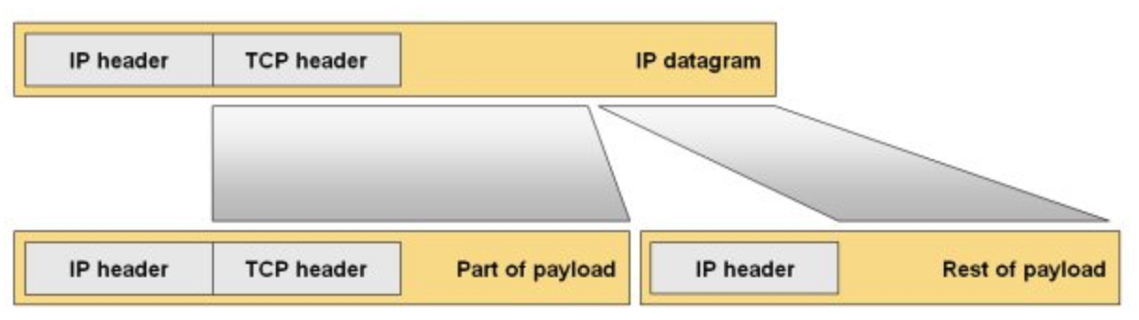
Illustration of Fragmentation
Payload
Note that the next layer header, e.g., Transport layer such as TCP or UDP,
is only in the first fragment.
The second and consecutive fragments only carry application data.

Slide 30
Where is fragmentation done?
fragmentation is done by the IP layer on a host or router at an interface that has an MTU that is smaller than the presented datagram size
fragments of the same datagram can be fragmented several times by routers on the path (S-D) when they encounter smaller MTUs
reassembly of original datagram is only done at destination device IP layer
Network Layer: Data Plane 4-30

Slide 31
Fragmentation impact on IP header
fragmentation affects the IP header (and of course the payload size
Network Layer: Data Plane 4-31

Slide 32
Header Manipulation
Identification when a datagram is fragmented, the identification is the same in all fragments
Flags DF bit is set: “=1” datagram cannot be fragmented and must be discarded if MTU is too small to carry it
MF bit set: “more” “bit = 1” - this datagram is a fragment and an additional fragment follows this one
“bit = 0 – last fragment of original datagram, no more fragments after this one
Fragment offset byte offset of the payload of the fragment in the original datagram (i.e., byte number of the first byte of the fragment payload wrt to original datagram position
Total length total length of the fragment

Slide 33
Datagram to Fragments
Byte number in original frame
byteZ
byte# Y+1
byte# Y
byte# X+1
byte #X
byte1
H
Fragment 1
H1
byte1
offset = 0
Fragment 2
H2
byte1 is byteX+1
offset = X/8
Why divisible by 8?
Fragment 3
H3
The max IP datagram
length is 2¹⁶
The fragment offset
field is 2¹³, it is <2¹⁶
To ref. every byte we need to
divide the payload by a numeral
that will enable offset to
reference it 2¹⁶/2¹³ = 2³ =8
byte1 is byteY+1
offset = Y/8
Fragment Length <
MTU size
Last byte in fragment
Frame
First byte in fragment
T
MTU
H
Fragment Payload = (last byte# – first byte# +1) and the length is divisible by 8
e.g., X=16, 16 – 1 = 15, +1 = 16/8 = 2

Slide 34
IP fragmentation – multiple segments
example:
4000 byte datagram = 20 + 3980
MTU = 1500 bytes
data = 1500-20 (IP header) = 1480bytes
3 fragments: 1480+1480+1020 = 3980
length
=4000
ID
=x
fragflag
=0, =0
offset
=0
last byte
byte #z
one large datagram becomes
several smaller datagrams
1stbyte
byte #1
last byte
byte #x
1480 +20 bytes in data field
length
=1500
ID
=x
fragflag
=0, =1
offset
=0
1stbyte
byte #x+1
length
=1500
ID
=x
fragflag
=0, =1
offset
=185
offset =1480/8=185
last byte
byte #Y
length
=1040
ID
=x
fragflag
=0,=0
offset
=370
offset =2x1480/8=370
last byte
byte #z
1stbyte
byte #y+1

Slide 35
Example of fragmentation
A datagram with size 2400 bytes must be fragmented to fit in an MTU of size 1000 bytes (IP header is 20bytes)
First Fragment:
MTU = 1000
Datagram = 2400 = 20 header + 2380 payload
MTU can carry 1000 – 20 (Header) = 980 data bytes
Fragments have to be multiple of 8 in size (2¹³).
So 980/8=122R4
Therefore carried payload will be 980-4=976 bytes
The first fragment will be 20 (Header) + 976 data = 996 in length.
Fragment offset will be 0 bytes.
Data remaining to be transmitted = 2380 – 976.
Offset of next datagram will be 976/8 = 122
Second Fragment:
Data remaining to be carried: 2380 – 976 = 1404 > 980 --> 976
The second fragment will be 20 (Header) + 976 data = 996 in length.
Fragment offset will be 122 bytes (size of 1st fragment payload).
Offset of next datagram will be 122 + 976/8 = 244
Third Fragment:
Data remaining to be transmitted = 2380 – 976 – 976 = 428
The 3rd fragment will be 20 (Header) + 428 data = 448 in length.
Fragment offset will be 244 bytes (size of 1st + 2nd fragment payloads).
Network Layer: Data Plane 4-35

Slide 36
Chapter 4: outline
4.1 Overview of Network layer
data plane
control plane
4.2 What’s inside a router
4.3 IP: Internet Protocol (v4)
IP Layer Services and Functions
datagram format
fragmentation
addressing
forwarding
4.4 IPv6
4.5 Internet Control Messaging Protocol (ICMP, ICMPv6)

Slide 37
What is an Internet address?
an Internet address is usually referred to as the IP (Internet Procotol) address - henceforth we will refer to it as an IP address
an IP address is a unique global address for a network device interface card
an IP address uniquely identifies the network that a device/host is attached to via an interface card
a device can have multiple network interface cards, each will have an IP address identifying the network it is connected to
Notes:
IP aliasing is associating more than one IP address to a network interface. With this, one node on a network
can have multiple connections to a network, each serving a different purpose.
IP aliasing can be used to provide multiple network addresses on a single physical interface.
This demonstrates using IP version 4 addresses only. One reason for using this could be to make a
computer look as though it is multiple computers, so for example you could have one server that is acting
as both a gateway (router) and a DHCP server and DNS using three different IP addresses, perhaps with
a future plan to use a hardware router and to move the functionality to separate DNS and DHCP servers.
Or indeed the opposite you could decide to replace the three different hardware devices with a single server
to reduce the administration overhead. In this case you can have three different addresses which are all on
the same computer without having to install many physical network interfaces. Another reason is that you
want to have the computer on two different logical network subnets whilst using a single physical interface.
For a router, you can have two subnets on one interface:
Router(config-if)# ip address ip-address mask secondary
Why?
There might not be enough host addresses for a particular network segment. For example, suppose your subnetting
allows up to 254 hosts per logical subnet, but on one physical subnet you must have 300 host addresses.
Using secondary IP addresses on the routers or access servers allows you to have two logical subnets using one physical subnet.
Note If any router on a network segment uses a secondary address, all other routers on that same segment must also use a
secondary address from the same network or subnet.
VLANS now used to solve a lot of these problems.

Slide 38
Internet Addressing: Specifics
IP address: 32-bit identifier for host, router associated with a network interface
interface: connection between host/router and physical link
router’s typically have multiple interfaces
each interface creates a distinct/separate network
hosts typically have one or two interfaces (e.g., wired Ethernet, wireless 802.11)
interfaces may or may not be on the same network
an IP address is associated with each interface
223.1.1.1
223.1.2.1
223.1.1.2
223.1.1.4
223.1.2.9
223.1.1.3
223.1.3.27
223.1.2.2
223.1.3.1
223.1.3.2
148.5.29.2

Slide 39
Addresses and Interface Cards
in a host
if the interface cards are attached to the same network (e.g., for redundancy) they will all identify the same network but will differ in some (least important) bits in the address (sometimes referred to as “host bits”)
an interface can have multiple IP addresses assigned to it – IP aliasing
in a router
a router can have two networks on one interface – unusual (secondary address)
BUT
a router cannot have two interfaces on same network
Notes:
IP aliasing is associating more than one IP address to a network interface. With this, one node on a network
can have multiple connections to a network, each serving a different purpose.
IP aliasing can be used to provide multiple network addresses on a single physical interface.
One reason for using this could be to make a
computer look as though it is multiple computers, so for example you could have one server that is acting
as both a gateway (router) and a DHCP server and DNS using three different IP addresses, perhaps with
a future plan to use a hardware router and to move the functionality to separate DNS and DHCP servers.
Or indeed the opposite you could decide to replace the three different hardware devices with a single server
to reduce the administration overhead. In this case you can have three different addresses which are all on
the same computer without having to install many physical network interfaces. Another reason is that you
want to have the computer on two different logical network subnets whilst using a single physical interface.
For a router, you can have two subnets on one interface:
Router(config-if)# ip address ip-address mask secondary
Why?
There might not be enough host addresses for a particular network segment. For example, suppose your subnetting
allows up to 254 hosts per logical subnet, but on one physical subnet you must have 300 host addresses.
Using secondary IP addresses on the routers or access servers allows you to have two logical subnets using one physical subnet.
Note If any router on a network segment uses a secondary address, all other routers on that same segment must also use a
secondary address from the same network or subnet.
VLANS now used to solve a lot of these problems.

Slide 40
Network number and host number
an IP address:
is a 32 bit long identifier – 4bytes
encodes a network part referred to as network number and a device part referred to as host number
the network number is assigned by a global organization
the host number is assigned locally in each network
human analogy:
network number → ``street name, city, state, country’’
host number → house number
if the interfaces are connected to the same network (i.,e., on the same street), they will only have a different host number (i.e., house number)
if they are connected to different networks, the network number (i.e., street name) (and possibly host number) will be different.
the size (i.e., no. of bits) of the network number is flexible
the size is indicated by a “network mask” and is called, or referred to as, the network prefix (more on that later)
network number
host number

Slide 41
IP Dotted Decimal Notation
IP addresses are written in a dotted decimal format
each byte is identified by a decimal number in the range [0….255] – 2⁸
Example:
10000000
10001111
10001001
10010000
1st Byte
= 128
2nd Byte
= 143
3rd Byte
= 137
4th Byte
= 144
128.143.137.144

Slide 42
Network prefixes and network masks
the network number is identified by a network mask
a network mask consists of contiguous “1’s” for the network number part and contiguous “0’s” for the host number
e.g., an IP address 143.12.10.1 has the network mask:
11111111.11111111.00000000.00000000 -> 255.255.0.0
Q: what is the network number for IP address 143.12.10.1?
A: if you AND the IP address and the network mask you get the network number.
Here 143.12.10.1 AND 255.255.0.0 -> 143.12.0.0
to simplify IP address notation we use the prefix notation:
143.12.10.1/x
/x denotes the number of contiguous “1’s” in the network mask
for our example 255.255.0.0 -> x=16
an IP address is generally given as: 143.12.10.1/16
a host number of “0” refers to the network ID – 143.12.0.0
a host number of all “1” refers to network broadcast address - 143.12.255.255 – all hosts react to the all “1” address

Slide 43
Networks, Devices and IP Addresses
IP address – 32 bits:
network number - high order bits – assigned globally
host number - low order bits – assigned locally
what comprises a network ?
device addresses with same network number
what does it mean?
devices on same network can physically reach each other without help of a router (they can directly ARP each other)
a router is required to send data from one network to another
Net 223.1.0.0
Net 223.1.1.0
Net 223.2.1.0
223.1.1.1
223.1.2.1
223.1.1.2
Router
223.1.1.4
223.1.2.9
223.1.1.3
223.1.3.27
223.1.2.2
Net 223.1.3.0
223.1.3.1
223.1.3.2
3 interconnected networks

Slide 44
How many distinct networks?
223.1.1.2
223.1.1.1
223.1.1.4
223.1.1.3
223.1.9.2
223.1.7.2
223.1.9.1
223.1.7.1
223.1.8.1
223.1.8.2
223.1.2.6
223.1.3.27
223.1.2.1
223.1.2.2
223.1.3.1
223.1.3.2

Slide 45
Network addresses
Q: how does an organization get a block of addresses (network number/ID)?
A: ICANN: Internet Corporation for Assigned
Names and Numbers http://www.icann.org/
allocates address blocks (cost based on network size defined by number of hosts network can support, i.e., “# of host bits”
manages DNS (Domain Name Servers that map Internet names to IP addresses)
assigns domain names, resolves disputes

Slide 46
Addressing in a large organization
usually an organization applies for one “network number” and pays for the size of the host space (i.e., # of host bits)
organizations have multiple departments
and departments want to manage their own networks (floor/bldg/function)
allocate a network number for each department? costly!
solution: introduce a hierarchy to the IP addressing structure only visible within the organization
Institutional Network
128.143.0.0
Engineering
School
Medical
School
Library
Subnetting

Slide 47
Basic Idea of Subnetting
cannot touch the network number – assigned globally
host number assigned locally
split the host number portion of an IP address into a
subnet number and a (smaller) host number
result is a 3-layer hierarchy
network number
host number
network number
subnet number
host number
extended network number
subnets can be freely assigned within the organization
internally, subnets are treated as separate networks
subnet structure is not visible outside the organization

Slide 48
Subnetting & extended mask/prefix
subnetting is done by allocating some of the leading bits of the host number to indicate a subnet number
with subnetting, the network number and the subnet number make up an extended network number
the extended number can be expressed in terms of a subnet mask (subnet prefix)
in our example 143.12.10.1/16, we will use the first byte of the host number (the third byte of the IP address) to denote the subnet number
so subnet mask = 16+8=24
255.255.255.0 is the subnet mask of the subnet
143.12.10.1/24 is the IP address of the host with new prefix = 24
143.12.10.0/24 is the subnet address the host is attached to
note that: 143.12.0.0/16 is the still the network address (or ID) (network prefix /16) of the organization and used to by Internet to route traffic to it
that network now has a subnet layer that is identified by 3rd byte NOT visible to outside world, only used internally.
network number - ID
(16)
subnet number
(8)
host number
(8)

Slide 49
Subnets
223.1.0.0
223.1.1.0/24
one large network:
223.1.0.0/16
comprised of 3 subnets interconnected via a router
each isolated network is called a subnet
223.1.1.0/24
223.1.2.0/24
223.1.3.0/24
223.1.2.0/24
223.1.1.1
223.1.2.1
223.1.1.2
223.1.1.4
223.1.2.9
223.1.1.3
223.1.3.27
subnet
223.1.2.2
223.1.3.1
223.1.3.2
223.1.3.0/24
subnet mask: /24

Slide 50
Advantages of Subnetting
with subnetting, IP addresses use a 3-layer hierarchy:
network
subnet
host
improves efficiency of IP addresses by not consuming an entire address space for each physical network
reduces router complexity.
since external routers do not know about subnetting, the complexity of routing tables at external routers is reduced
note: length of the subnet mask need not be identical for all subnetworks within a campus network

Slide 51
Examples of Prefix Addressing
148.187.97.156/x = 10010100.10111011.01100001.10011100/x
X = 8 -> subnet mask? 11111111.0.0.0 -> 255.0.0.0
Netword ID? Subnet mask AND IP Address
11111111.00000000.00000000.00000000
AND
10010100.10111011.01100001.10011100
Network ID: 148.0.0.0
X = 12 -> subnet mask? 11111111.11110000.0.0 -> 255.192.0.0
Netword ID? Subnet mask AND IP Address
11111111.11110000.00000000.00000000
AND
10010100.10111011.01100001.10011100
Network ID: 148.176.0.0
X = 22 -> subnet mask? 11111111.11111111.11111100.0 -> 255.255.252.0
Netword ID? Subnet mask AND IP Address
11111111.11111111.11111100.00000000
AND
10010100.10111011.01100001.10011100
Network ID: 148.187.96.0

Slide 52
An example of subnetting
Given: a campus network address of 125.36.0.0/16
create subnets that can accommodate maximum of 500 hosts each (all 1’s and all 0s cannot be used for host bits, reserved – so max host# +2 is required host space)
Steps to create subnets and host number space:
125.36 → cannot be touched – assigned
rightmost 32-16 =16 bits of this network address are ‘host’ bits
0.0 → (host bits) –> 8 + 8 = 16 bits
500+2 hosts require “x” bits for host addressing
2^{x} > 502, what is x? 2⁸ = 256 < 502 < 2⁹ = 512 → x=9
we need 9 bits to accommodate the required number of hosts for this network
what remains can be used for subnetting:
subnet address space = 16 – bits required for hosts = 16 - x
x = 9, therefore # of bits available for subnets = 16 – 9 = 7
7 bits left for subnetting → 2⁷=128 subnets with 512 hosts/subnet
subnet addresses: {0,1, 2, 3, 4….127}

Slide 53
An example of subnetting
Given: a campus network prefix of 125.36.0.0/16
create 5 subnets to accommodate a minimum of 250 hosts each
Network ID:125.36 → cannot be touched - assigned
0.0 → (subnet + host bits) –> 8 + 8 = 16 bits
need only 5 subnets: 2²=4 < 5 –> not enough, 2³=8 > 5 → 3 bits
subnet addresses: {0,1, 2, 3, 4, 5, 6, 7}
host address space = 16 – 3 subnet bits =13bits -> 2¹³ >250
125.36.0.0 campus network - possible subnets
125.36.xxxxxxxx.xxxxxxxx → xxx -> 2³ = {0,1,2,3,4,5,6,7}
Sample subnets with subnet prefix 16+3 = 19:
125.36.00100000.00000000 → 125.36.32.0/19
125.36.01000000.00000000 → 125.36.64.0/19
125.36.01100000.00000000 → 125.36.96.0/19
125.36.10000000.00000000 → 125.36.128.0/19
125.36.10100000.00000000 → 125.36.160.0/19

Slide 54
Another example
Given: a campus network ID of 125.36.0.0/18
create 10 subnets for this campus network
125.36.00 (=18) → cannot be touched - assigned
000000.0 → (subnet + host bits) –> 6 + 8 = 14 bits
rightmost 14 bits of this campus IP address are “subnet + host” bits
need 10 subnets → 2³ = 8 < 10, 2⁴ = 16 → 4 bits
subnet addresses: {0,1, 2, ……, 15}
leaves 14 - 4 = 10bits for host addresses -> 2¹⁰ = 1024 addresses
125.36.0.0/18 campus network, possible subnets:
xxxxxxxx.xxxxxxxx → xxxx – {0,1,2,3,...15}
example subnet IDs with prefix 18 + 4 = 22:
125.36.00000000.00000000 → 125.36.0.0/22
125.36.00000100.00000000 → 125.36.4.0/22 (3rd byte: 00000100=4)
125.36.00001000.00000000 → 125.36.8.0/22 (3rd byte: 00001000=8)
125.36.00001100.00000000 → 125.36.12.0/22 (3rd byte: 00001100=12)
125.36.00100100.00000000 → 125.36.36.0/22
125.36.00101000.00000000 -> 125.36.40.0/22

Slide 55
Another example
Given previous example, 2 subnets are subnetted further into 2 subnets, each to accommodate max. of 500 hosts each.
assume we used subnet IDs {0,1,…9} → {0000, 0001, 0010,…. 1001}
use subnets 0000 and 0001 to further subnet in two subnets
125.36.00000000.00000000 → 125.36.0.0/22
125.36.00000100.00000000 → 125.36.4.0/22
500 hosts --> 2⁹ = 512, we need to allocate 9 bits for host address
125.36.0000000x.xxxxxxxx/22
125.36.0000010x.xxxxxxxx/22
two subnets need 1 bit (0, 1)
125.36.000000?x.xxxxxxxx
125.36.000001?x.xxxxxxxx
subnet ID prefixes for these new subnets will be: 22 + 1 = 23
Subnet IDs will be: subnet numbers now are: 0000xx, 0001xx
00000, 00001 → 0, 2 -> 125.36.00000000.00000000/23, 125.36.00000010.00000000/23
00010, 00011 → 4, 6 -> 125.36.00000100.00000000/23, 125.36.00000110.00000000/23

Slide 56
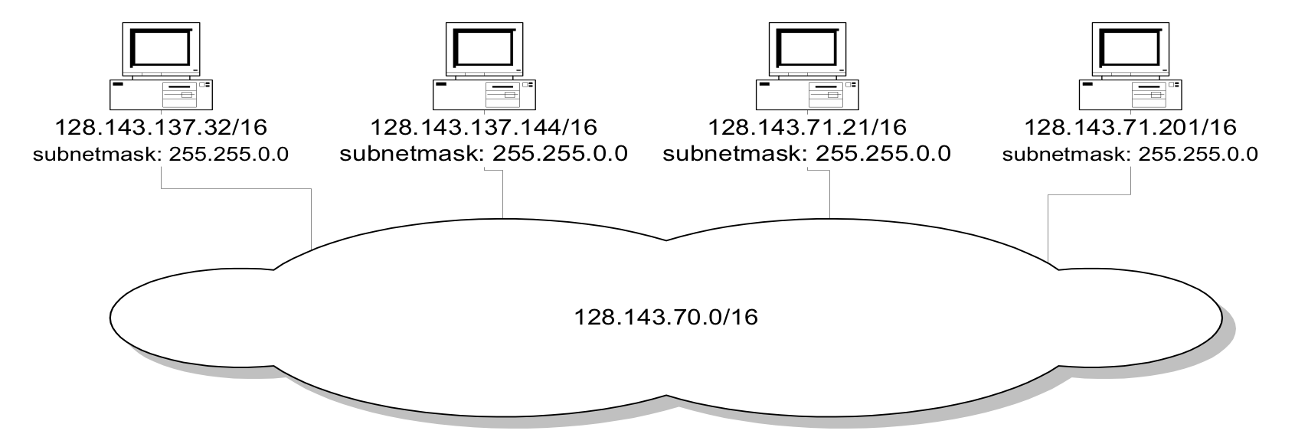
Network without subnets
128.143.0.0/16

Slide 57
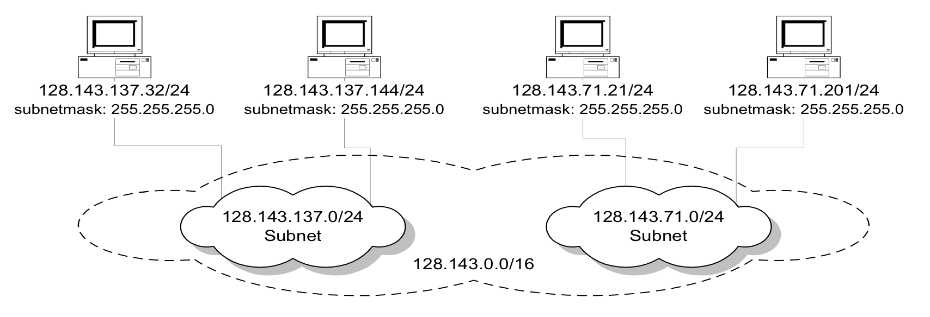
Same network with subnets

Slide 58
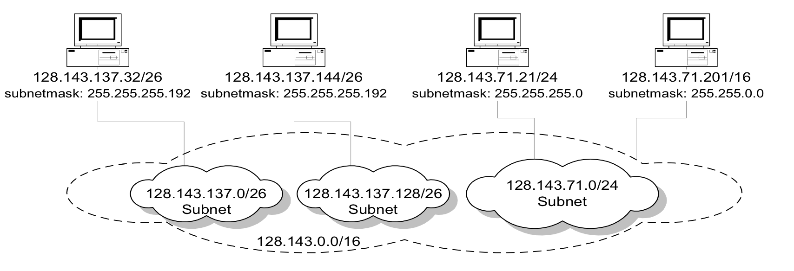
Same network with more subnetmasks
128.143.137.0/24
Subnet

Slide 59
Final subnetting example
an organization with 4 departments has the following IP address space: 10.2.22.0/23. As the systems manager, you are required to create subnets to accommodate the IT needs of 4 departments. The subnets have to support up to 200, 71, 55, and 41 hosts respectively. What are the 4 subnet network numbers?
solution:
10.2.22.0/24 (256 addresses > 200)
10.2.23.0/25 (128 addresses >71)
10.2.23.128/26 (64 addresses > 55)
10.2.23.192/26 (64 addresses > 41)

Slide 60
Subnetting example with different subnet sizes
an organization with 4 departments has the following IP address space: 10.2.22.0/23. As the systems manager, you are required to create subnets to accommodate the IT needs of 4 departments. The subnets have to support up to 200, 71, 55, and 41 hosts respectively. What are the 4 subnet network numbers?
solution:
10.2.22.0/24 (2⁸=256 addresses > 200)
10.2.23.0/25 (2⁷=128 addresses >71)
10.2.23.192/26
10.2.23.192/26 (2⁶=64 addresses > 55)
10.2.23.128/26 (2⁶=64 addresses > 41)
10.2.22.0/23
x.xxxxxxxx
0 or 1 with 2⁸ (256) hosts -> 1st subnet –
x=0 -> 10.2.22.0/24. x=1 for next tier
0 or 1 with 2⁷ (128) hosts -> 2nd subnet -
x=0 -> 10.2.23.128/25. x=1 for next tier
0 or 1 with 2⁶ (64) hosts -> 3rd and 4th subnets
x=1 3rd subnet 10.2.23.192/26
x=0 4th subnet 10.0.22.128/26

Slide 61
Example of a subnetting plan
Internet
Subnet 128.49.2.0/24
Subnet 2
0=00000000
Subnet 128.49.1.0/25
Subnet 4
Router
R
Subnet 128.49.1.128/25
Subnet 5
128=10000000
Subnet 1: 128.49.1.0/24
Subnet 3
Subnet 128.49.3.0/24
2 bytes available for subnetting
IP Network: 128.49.0.0/16

Slide 62
Hierarchical addressing: route aggregation
hierarchical addressing allows efficient advertisement of routing information:
ISP-1's block 11001000 00010111 00010000 00000000 200.23.16.0/20
Organization 0 11001000 00010111 00010000 00000000 200.23.16.0/23
Organization 1 11001000 00010111 00010010 00000000 200.23.18.0/23
Organization 2 11001000 00010111 00010100 00000000 200.23.20.0/23
... ….. …. ….
Organization 7 11001000 00010111 00011110 00000000 200.23.30.0/23
Organization 0
200.23.16.0/23
Organization 1
“Send me anything
with addresses
beginning with
200.23.16.0/20”
200.23.18.0/23
Organization 2
.
200.23.20.0/23
.
ISP-1
.
.
Internet
.
Organization 7
.
200.23.30.0/23
ISP-2

Slide 63
CIDR - Classless InterDomain Routing
builds on the flexible netmask concept
restructure IP address assignments to increase efficiency
hierarchical routing aggregation to minimize route table entries
Key Concept: the length of the network id (prefix) in IP addresses is arbitrary/flexible and is defined by the network hierarchy.
consequence:
routers use the IP address and the length of the prefix for forwarding.
all advertised IP addresses must include a prefix

Slide 64
IP addressing and CIDR
subnet portion of address of arbitrary length
address format: a.b.c.d/x, where x is # bits in subnet portion of address
subnet
part
host
part
11001000 00010111 00010000 00000000
200.23.16.0/23

Slide 65
CIDR Example
assume that a site requires an IP network domain that can support 1000 IP host addresses
with CIDR, the network is assigned a continuous block of:
1024 = 2¹⁰ (>1000) addresses
with a 32-10 = 22-bit long prefix

Slide 66
CIDR: prefix value vs. host space
CIDR Block Prefix # of Host Addresses
/27 32 hosts
/26 64 hosts
/25 128 hosts
/24 256 hosts
/23 512 hosts
/22 1,024 hosts
/21 2,048 hosts
/20 4,096 hosts
/19 8,192 hosts
/18 16,384 hosts
/17 32,768 hosts
/16 65,536 hosts
/15 131,072 hosts
/14 262,144 hosts
/13 524,288 hosts

Slide 67
CIDR and Address assignments
Backbone ISPs obtain large blocks of IP address space and then reallocate portions of their address blocks to their customers.
example:
assume that an ISP owns the address block 206.0.64.0/18
206.0.01000000.0/18
32-18 = 14 represents 2³²⁻¹⁸=2¹⁴ IP host addresses
suppose a client requires 800 host addresses
512=2⁹<800<1024=2¹⁰ -> 32-10 = 22
assign a /22 block – 206.0.01????xx.xxxxxxxx/22
e.g., 206.0.010001xx.xxxxxxxx -> 206.0.68.0/22 allocates a block of 1,024 (2¹⁰) IP addresses to client

Slide 68
Example CIDR Address Assignment
Company X :
206.0.68.0/22
ISP X owns:
206.0.64.0/18
204.188.0.0/15
209.88.232.0/21
Internet Backbone
ISP y :
209.88.237.0/24
Organization z1 :
209.88.237.192/26
Organization z2 :
209.88.237.0/26

Slide 69
Example CIDR Address Assignment
Backbone routers do not know anything about Company X, ISP Y, or Organizations Z1, Z2.
Company X :
206.0.68.0/22
ISP K owns:
ISP K sends everything which matches the prefix: 206.0.68.0/22 to Company X,
209.88.237.0/24 to ISP Y
206.0.64.0/18
204.188.0.0/15
209.88.232.0/21
ISP Y sends everything which matches the prefix: 209.88.237.192/26 to Organizations Z1 209.88.237.0/26 to Organizations Z2
Internet Backbone
ISP K does not know about Organizations Z1, Z2.
Backbone sends everything which matches the prefixes 206.0.64.0/18, 204.188.0.0/15, 209.88.232.0/21 to ISP K.
ISP Y :
209.88.237.0/24
Organization Z1 :
209.88.237.192/26
Organization Z2 :
209.88.237.0/26

Slide 70
IP address: how to get one?
Q: How does a router get IP address?
hard coded by system admin
every interface/port is assigned a unique IP address reflecting network assignment
Q: How does a host get IP address?
hard-coded by system admin in a file
Windows: control-panel->network->configuration->tcp/ip->properties
UNIX: /etc/rc.config
DHCP: Dynamic Host Configuration Protocol: dynamically get address from as server
“plug-and-play”
223.1.2.9
223.1.1.4
223.1.1.0
223.1.2.0
223.1.3.2
223.1.3.0

Slide 71
Chapter 4: outline
4.1 Overview of Network layer
data plane
control plane
4.2 What’s inside a router
4.3 IP: Internet Protocol (v4)
IP Layer Services and Functions
datagram format
fragmentation
addressing
forwarding
4.4 IPv6
4.5 Internet Control Messaging Protocol (ICMP, ICMPv6)

Slide 72
IP Forwarding
in a network: process of getting from source to destination – moving forward hop-by-hop
usually requires a routing function that determines the hop-by-hop sequence to follow and referred to as routing
in a router: move packets from router’s input to appropriate router output
uses the routing information that determines the next hop for a destination and from that determines the interface leading to that next hop to forward the datagram

Slide 73
Hop-by-Hop Delivery of a datagram
view at the IP layer:
an IP network is a logical entity with a network (subnet) number
we represent an IP network as a “cloud”
IP delivery service is hop-by-hop across clouds of networks/subnets
IP

Slide 74
Under the Hood
view at the data link layer layer:
the clouds consist of collection of LANs, switched LANs, point-to-point links, that are connected by routers
IP

Slide 75
Destination Based Forwarding
forward datagram based only on destination IP address
look up output port using forwarding table
forwarding table maps IP destinations to:
outgoing interfaces – direct connection
next hop router – intermediate hop

Slide 76
Tenets of end-to-end delivery of datagrams
The following conditions must hold so that an IP datagram can be successfully delivered
The network prefix of an IP destination address must correspond to a unique network interface – i.e., a data link layer network (LAN or point-to-point link or switched network).
Routers and hosts that have a common network prefix must be able to exchange IP datagrams using a data link protocol (e.g., Ethernet, PPP).
An IP network is formed when a data link layer network is connected to at least one other data link layer network via a router. Each router interface is an IP network.

Slide 77
Processing of an IP datagram in IP
processing of IP datagrams is very similar on an IP router and a host
main difference: “IP forwarding” is enabled on router and disabled on host
IP forwarding enabled → if a datagram is received, but it is not for the local system, the datagram will be sent to a different system
IP forwarding disabled → if a datagram is received, but it is not for the local system, the datagram will be discarded

Slide 78
Processing of IP datagram at a Host
Receive an IP datagram
IP header validation (error checking). Fails, drop datagram.
Datagram addressed to this host? No, ignore (i.e, drop).
If error in a header field (not caught by checksum or error by source), e.g., non existing upper layer, non existing port, etc., send ICMP packet reporting error
If no errors, pass payload to identified next layer.
ICMP – IP control protocol used for reporting errors to datagram delivery to source.
More later.

Slide 79
Processing of IP datagram at a router
Receive an IP datagram
IP header validation. Fails, drop datagram.
Process options in IP header
Datagram addressed to this router? No
Forwarding table lookup for address – obtain outgoing interface
Decrement TTL
Perform fragmentation (if necessary)
Calculate checksum
Forward to link or next hop
OR
Send ICMP packet to source (if error in steps 4., 5. or 6.)

Slide 80
Forwarding tables
Each router and each host maintains a forwarding table which tells the router how to process an outgoing packet
Main columns:
Destination address: where is the IP datagram going to?
Next hop or interface: how to send the IP datagram?
Forwarding tables are setup so that a datagram gets closer to its destination with every hop
Forwarding table of a host or router
IP datagrams can be directly delivered (“direct” via an interface) or are sent to a next hop router (R1,R2,R4).
Entry in table will give interface number (e.g., eth0) or IP address of next hop router (e.g., R2=10.2.1.5)
Destination | Next Hop
20.2.1.0/28 10.1.0.0/24 10.1.2.0/24 10.2.1.0/24 10.3.1.0/24 20.1.0.0/16 | direct R2 R4 direct direct R1

Slide 81

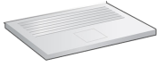

Example of Next Hops
10.0.96.0/19
10.0.96.1/19
eth0
ser1
10.0.192.1/18
10.0.192.11/18
R2
eth1
10.0.192.0/18
ser1
12.0.160.1/19
eth1
Destination | Next Hop
10.0.96.0/19 10.0.160.0/19 10.0.192.0/18 20.160.0.0/14 Default (0.0.0.0) | (direct) eth0 (direct) eth1 (direct) ser1 (R2) IPaddr (R2) IPaddr
20.160.0.1/14
12.0.160.0/19
20.160.0.0/14

Slide 82
Types of forwarding table entries
Network route (prefix 1-31)
Destination addresses is a network address (e.g., 10.0.2.0/24)
Most entries are network routes
Host route (prefix 32)
Destination address is an interface address (e.g., 10.0.1.2/32)
Used to specify a separate route for certain hosts
Default route (prefix 0)
Used when no network or host route matches
The router that is listed as the next hop of the default route is the default gateway (for Cisco: “gateway of last resort)
Loopback address (prefix 8)
Routing table for the loopback address (127.0.0.1)
The next hop lists the loopback (lo0) interface as outgoing interface

Slide 83
Forwarding table lookup
Destination address | Next hop
network prefix (/1-31) or host IP address (/32) or loopback address (/8) or default route (/0) | IP address of next hop router* or Name of a network interface
When a router or host needs to transmit an IP datagram, it performs a routing table lookup
Routing table lookup: Use the IP destination address as a key to search the routing table.
Result of the lookup is the IP address of a next hop router, or the name of a network interface
* Note: A router has many IP addresses. The IP address in the routing table refers to the address of the network interface of next hop router on the same directly connected network.

Slide 84
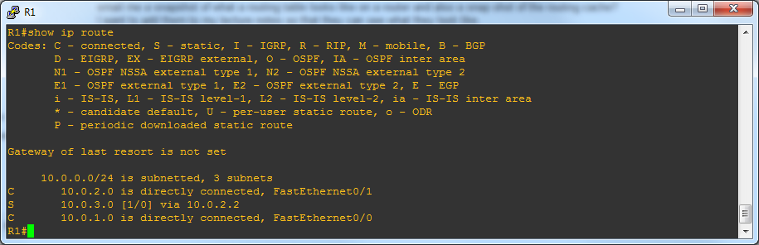
Typical Forwarding Table at:
Host
Destination Gateway Genmask Flags Iface
10.0.96.100 10.0.160.1 255.255.255.255 UGH eth0
10.0.32.0 10.0.192.2 255.255.224.0 UG eth1
10.0.96.0 10.0.160.1 255.255.224.0 UG eth0
10.0.64.0 10.0.192.1 255.255.224.0 UG eth1
10.0.160.0 *(direct) 255.255.224.0 U eth0
10.0.192.0 *(direct) 255.255.224.0 U eth1
127.0.0.1 * 255.0.0.0 U lo
0.0.0.0(default) 10.0.160.2 0.0.0.0 UG eth0
Router
Prefix
/32
/19
/19
/19
/19
/19
/8
/0

Slide 85
Longest Prefix Match
128.143.71.21
Longest Prefix Match: Search for the routing table entry that has the longest prefix match with the destination IP address. WHY?
The longer the prefix the closer you are to destination….
Search for a match on all 32 bits
Search for a match for 31 bits
…..
32. Search for a match on 0 bits
Host route → 32-bit prefix match
Default route is represented as 0.0.0.0/0 → 0-bit prefix match
The longest prefix match for 128.143.71.21 is for 20 bits with entry 128.143.64.0/20
Datagram will be sent to R4
Matches but prefix 16 < 20

Slide 86

Forwarding to an interface
20.2.1.0
R4
128.5.2.1
IP Dest:
10.2.1.55
?
10.4.2.0
?
10.4.2.2
136.4.33.2
Datagram
eth0
ser0
10.3.1.0
eth2
?
eth1
?
10.2.1.0
Destination | Next Hop
20.2.1.0/28 10.4.2.0/24 10.1.2.0/24 10.2.1.0/24 10.3.1.0/24 20.1.0.0/16 | eth0 ser0 R4 eth1 eth2 R4
10.2.1.55/28 = 20.2.1.0
10.2.1.55/24 = 10.4.2.0
10.2.1.55/24 = 10.1.2.0
10.2.1.55/24=10.2.1.0

Slide 87
Forwarding to a Router as next hop
10.1.2.0
20.2.1.0
10.1.2.1
R4
128.5.2.1
IP Dest:
10.1.2.65
?
10.4.2.0
?
10.4.2.2
136.4.33.2
Datagram
eth0
ser0
10.3.1.0
eth2
?
eth1
?
10.2.1.0
Destination | Next Hop
20.2.1.0/28 10.4.2.0/24 10.1.2.0/24 10.2.1.0/24 10.3.1.0/24 20.1.0.0/16 | eth0 ser0 R4(10.4.2.2) eth1 eth2 R4
10.1.2.65/28 = 20.2.1.0
10.1.2.65/24 = 10.4.2.0
10.1.2.65/24 = 10.1.2.0
Route to R4 – IP address 10.4.2.2
10.4.2.2/28 = 20.2.1.0
10.4.2.2/24 = 10.4.2.0
87

Slide 88
Constructing a Network Topology from a Host’s Forwarding Table
Destination | Router/ Interface
10.0.96.100/32 | 10.0.160.1 (R1)
10.0.32.0/19 | 10.0.192.2 (R2)
10.0.96.0/19 | 10.0.160.1 (R1)
10.0.64.0/19 | 10.0.192.1 (R3)
10.0.160.0/19 | eth0
10.0.192.0/19 | eth1
127.0.0.0/8 | lo
0.0.0.0 | 10.0.160.2 (R4)
10.32.0.0/19
R2
R3
10.0.64.0/24
10.0.192.0/19
All other destinations
eth1
R4
eth0
10.0.160.0/19
R1
10.0.96.0/24
10.0.96.100/24

Slide 89
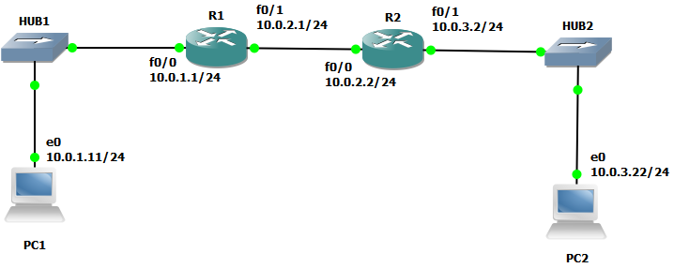
GNS3 Example

Slide 90
Forwarding Table and Routing Cache
every router has a routing table
from routing table a forwarding table is created
once a destination has been looked up in the forwarding table, it is placed in a route cache

Slide 91
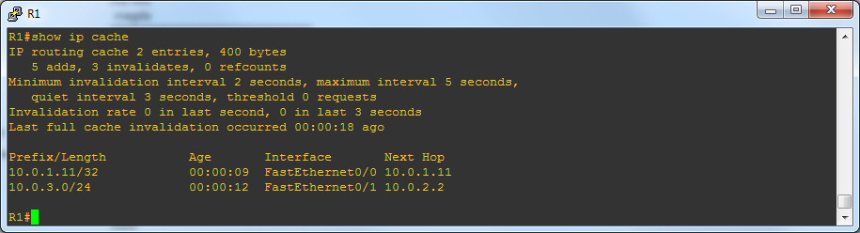
Forwarding Table & Cache on R1

Slide 92
Path Aggregation
Longest prefix match algorithm permits the aggregation of prefixes with identical next hop address to a single entry
This contributes significantly to reducing the size of routing tables of Internet routers
20.2.0.0/16 -> 20.00000010.0.0
20.3.1.0/28 -> 20.00000011.00000001.00000000
8+7=15
Destination | Next Hop
10.1.0.0/24 10.1.2.0/24 10.2.1.0/24 10.3.1.0/24 20.2.0.0/16 20.3.1.0/28 | R3 direct direct R3 R2 R2
Destination | Next Hop
10.1.0.0/24 10.1.2.0/24 10.2.1.0/24 10.3.1.0/24 20.0.2.0/15 | R3 direct direct R3 R2

Slide 93

Addressing: routing to another LAN
walkthrough: send datagram from A to B via R
focus on addressing – at IP (datagram) and MAC layer (frame)
assume A knows B’s IP address
assume A knows IP address of first hop router, R (routing table)
assume A knows R’s MAC address (ARP)
A
B
R
111.111.111.111
222.222.222.222
74-29-9C-E8-FF-55
49-BD-D2-C7-56-2A
222.222.222.220
1A-23-F9-CD-06-9B
111.111.111.112
111.111.111.110
222.222.222.221
CC-49-DE-D0-AB-7D
E6-E9-00-17-BB-4B
88-B2-2F-54-1A-0F

Slide 94
Addressing: routing to another LAN
A creates IP datagram with IP source A, destination B
A creates link-layer frame with R's MAC address as dest, frame contains A-to-B IP datagram
MAC src: 74-29-9C-E8-FF-55
MAC dest: E6-E9-00-17-BB-4B
IP
Eth
Phy
IP src: 111.111.111.111
IP dest: 222.222.222.222
A
B
R
111.111.111.111
222.222.222.222
74-29-9C-E8-FF-55
49-BD-D2-C7-56-2A
222.222.222.220
1A-23-F9-CD-06-9B
111.111.111.112
111.111.111.110
222.222.222.221
CC-49-DE-D0-AB-7D
E6-E9-00-17-BB-4B
88-B2-2F-54-1A-0F

Slide 95
Addressing: routing to another LAN
frame sent from A to R
frame received at R, datagram extracted, passed up to IP
MAC src: 74-29-9C-E8-FF-55
MAC dest: E6-E9-00-17-BB-4B
IP src: 111.111.111.111
IP dest: 222.222.222.222
IP
Eth
Phy
IP src: 111.111.111.111
IP dest: 222.222.222.222
IP
Eth
Phy
A
B
R
111.111.111.111
222.222.222.222
74-29-9C-E8-FF-55
49-BD-D2-C7-56-2A
222.222.222.220
1A-23-F9-CD-06-9B
111.111.111.112
111.111.111.110
222.222.222.221
CC-49-DE-D0-AB-7D
E6-E9-00-17-BB-4B
88-B2-2F-54-1A-0F

Slide 96
Addressing: routing to another LAN
R forwards datagram with IP source A, destination B
R creates link-layer frame with B's MAC address as dest, frame contains A-to-B IP datagram
MAC src: 1A-23-F9-CD-06-9B
MAC dest: 49-BD-D2-C7-56-2A
IP
Eth
Phy
IP
Eth
Phy
IP src: 111.111.111.111
IP dest: 222.222.222.222
A
B
R
111.111.111.111
222.222.222.222
74-29-9C-E8-FF-55
49-BD-D2-C7-56-2A
222.222.222.220
1A-23-F9-CD-06-9B
111.111.111.112
111.111.111.110
222.222.222.221
CC-49-DE-D0-AB-7D
E6-E9-00-17-BB-4B
88-B2-2F-54-1A-0F

Slide 97
Addressing: routing to another LAN
R forwards datagram with IP source A, destination B
R creates link-layer frame with B's MAC address as dest, frame contains A-to-B IP datagram
MAC src: 1A-23-F9-CD-06-9B
MAC dest: 49-BD-D2-C7-56-2A
IP
Eth
Phy
IP
Eth
Phy
IP src: 111.111.111.111
IP dest: 222.222.222.222
A
B
R
111.111.111.111
222.222.222.222
74-29-9C-E8-FF-55
49-BD-D2-C7-56-2A
222.222.222.220
1A-23-F9-CD-06-9B
111.111.111.112
111.111.111.110
222.222.222.221
CC-49-DE-D0-AB-7D
E6-E9-00-17-BB-4B
88-B2-2F-54-1A-0F

Slide 98
Addressing: routing to another LAN
R forwards datagram with IP source A, destination B
R creates link-layer frame with B's MAC address as dest, frame contains A-to-B IP datagram
MAC src: 1A-23-F9-CD-06-9B
MAC dest: 49-BD-D2-C7-56-2A
IP src: 111.111.111.111
IP dest: 222.222.222.222
IP
Eth
Phy
A
B
R
111.111.111.111
222.222.222.222
74-29-9C-E8-FF-55
49-BD-D2-C7-56-2A
222.222.222.220
1A-23-F9-CD-06-9B
111.111.111.112
111.111.111.110
222.222.222.221
CC-49-DE-D0-AB-7D
E6-E9-00-17-BB-4B
88-B2-2F-54-1A-0F

Slide 99


Local/Adjacent and Remote devices
All devices are on same “network” (137.196.7) can find and reach each other via MAC address
Devices on different “network” (137.196.49) can only be reached via a router using network address
137.196.7.78
137.196.7.1
bd-c4-11-af-55-03
137.196.49.1
1a-2f-bb-76-09-ad
f4-18-13-df-57-93
137.196.7.23
LAN
137.196.7.14
137.196.49.51
LAN
71-65-f7-2b-08-53
58-23-d7-fa-20-b0
18-a4-d7-fa-20-c0
0c-c4-11-6f-e3-98
137.196.49.3
137.196.7.88

Slide 100
Remote devices
Devices on different “networks” (137.196.49) can only be reached via a router.
That means that the host cannot ARP for the remote host, uses a next hop router.
Host 137.196.7.88 will ARP for ROUTER 137.196.7.1 interface MAC address
Then ROUTER will ARP for Host 137.196.49.3 interface MAC address
137.196.7.78
137.196.7.1
bd-c4-11-af-55-03
137.196.49.1
1a-2f-bb-76-09-ad
f4-18-13-df-57-93
137.196.7.23
ROUTER
LAN
137.196.7.14
137.196.49.51
LAN
71-65-f7-2b-08-53
58-23-d7-fa-20-b0
18-a4-d7-fa-20-c0
0c-c4-11-6f-e3-98
137.196.49.3
137.196.7.88

Slide 101
What happens when a host has a larger view of network?
larger view -> means shorter prefix, i.e., does not see the local subnets
Host 223.1.1.1/16 thinks that all PCs with 223.1.0.0 prefix are in its local subnet and it will not ask the local (default router) to forward the datagram to any of the PCs
Network view of Host:223.1.1.1/16 = 223.1.0.0
Network view of Host for PC2:223.1.3.1/16 = 223.1.0.0
Host will directly ARP for PC2
Can PC2 respond?
NO. It is not on the same network, no one will respond to the ARP
Solution: Proxy ARP!
Host: 223.1.1.1/16
223.1.0.0/16
223.1.2.1/24
223.1.1.2/24
Router
223.1.1.4/24
223.1.2.9/24
223.1.1.0/24
223.1.2.0/24
223.1.1.3/24
223.1.3.27/24
223.1.2.2/24
223.1.3.0/24
223.1.3.2/24
PC2: 223.1.3.1/24

Slide 102
Proxy ARP
Host will directly ARP for PC2
Proxy ARP - router intervenes:
will notice that Host is looking for a remote host PC2 not on the local network
it will respond with its own hardware address, pretending to be PC2, then forward packet
we call this Proxy ARP, the router masquerades as the remote PC (PC2) for Host
only applied when the router has a viable/routable path to both local PC (Host) and remote PC, PC2 in this case
not as popular anymore with use of DHCP (security problems)
used in smaller networks that did not use dynamic routing (i.e., system admin had to setup routing tables in hosts)
Cisco routers have it set by default
Host: 223.1.1.1/16
223.1.0.0/16
223.1.2.1/24
Router
223.1.1.2/24
223.1.1.4/24
223.1.2.9/24
223.1.1.0/24
223.1.2.0/24
223.1.1.3/24
223.1.3.27/24
223.1.2.2/24
223.1.3.0/24
223.1.3.2/24
PC2: 223.1.3.1/24

Slide 103
Example: Host to PC2
Host: ARP Request for PC2
Host: Datagram for PC2
Host: 223.1.1.1/16
223.1.0.0/16
223.1.2.1/24
223.1.1.2/24
Router
223.1.1.4/24
223.1.2.9/24
223.1.1.0/24
223.1.2.0/24
R: ARP Reply to Host
223.1.1.3/24
Router R
223.1.3.27/24
R: ARP Request for PC2
223.1.2.2/24
R: Datagram from Host for PC2
X
223.1.3.0/24
223.1.3.2/24
PC2: 223.1.3.1/24
PC2
PC2: ARP Reply to R
PC2

Slide 104
ARP Cache in ARP vs Proxy ARP Example
Non Proxy ARP – Host /24:
Host will ARP for Router – normal operation
Host’s ARP cache – has IP address of Router
(223.1.1.4/24) at 00:e0:f9:23:a8:20 [ether] on eth0
Proxy ARP – Host /16:
Host will ARP for PC2 – proxy ARP used by Router
Host’s ARP cache – has IP address of PC2
(223.1.3.1/16) at 00:e0:f9:23:a8:20 [ether] on eth0

Slide 105
Summary: Proxy Arp
allows devices on two different IP subnetworks to share a single IP network prefix
Source believes destination is on same IP network
must configure router to respond to ARP broadcast requests for destinations on different connected subnet
router masquerades as destination for ARP request sent by source on a subnet
the two devices are unaware that they are on different subnets, subnet mask indicates that they have the same network prefix.
masquerades: router responds to broadcast ARP Request from source host that arrives on one of its connected networks for a destination host that is on one of its other connected networks.

Slide 106
Chapter 4: outline
4.1 Overview of Network layer
data plane
control plane
4.2 What’s inside a router
4.3 IP: Internet Protocol
datagram format
fragmentation
IPv4 addressing
DHCP
IPv4 forwarding
ICMP
IPv6

Slide 107
ICMP: internet control message protocol
used by hosts & routers to communicate network-level information
error reporting: unreachable host, network, port, protocol – original (errored) datagram discarded after ICMP error message created with error info that is sent back to source
queries: echo request/reply (used by ping), timestamps, router advertisements
network-layer “above” IP:
ICMP msgs carried/transported in IP datagrams
ICMP Message – min 8 bytes

Slide 108
ICMP Query message
ICMP query:
Request sent by host to a router or host
Reply sent back to querying host

Slide 109
Example of ICMP Queries
Type/Code: Description
8/0 Echo Request
0/0 Echo Reply
13/0 Timestamp Request
14/0 Timestamp Reply
10/0 Router Solicitation
9/0 Router Advertisement
The ping command uses Echo Request/ Echo Reply

Slide 110
Ping and ICMP
PC% ping IPAddress
PC calculates the RTT and displays on screen
PC also keeps statistics on number of transmitted requests and received replies
ICMP Echo Request
ICMP Echo Reply

Slide 111
ICMP Router Solicitation ICMP Router Advertisement
after starting up, a router broadcasts an ICMP router solicitation.
in response, routers send an ICMP router advertisement message
also, routers periodically broadcast ICMP router advertisement
has nothing to do with routing protocols
-> this is sometimes called the Router Discovery Protocol

Slide 112
ICMP Error message
ICMP error messages report error conditions
Typically sent when a datagram is discarded
Error message is often passed from ICMP to the application program

Slide 113
ICMP Error message
ICMP error messages include the complete IP header and the first 8 bytes of the payload (typically: UDP, TCP)

Slide 114
Common ICMP Error messages
Type | Code | Description
3 | 0–15 | Destination unreachable | Notification that an IP datagram could not be forwarded and was dropped. The code field contains an explanation.
5 | 0–3 | Redirect | Informs about an alternative route for the datagram and should result in a routing table update. The code field explains the reason for the route change.
11 | 0, 1 | Time exceeded | Sent when the TTL field has reached zero (Code 0) or when there is a timeout for the reassembly of segments (Code 1)
12 | 0, 1 | Parameter problem | Sent when the IP header is invalid (Code 0) or when an IP header option is missing (Code 1)

Slide 115
Some subtypes of the “Destination Unreachable”
Code | Description | Reason for Sending
0 | Network Unreachable | No routing table entry is available for the destination network.
1 | Host Unreachable | Destination host should be directly reachable, but does not respond to ARP Requests.
2 | Protocol Unreachable | The protocol in the protocol field of the IP header is not supported at the destination.
3 | Port Unreachable | The transport protocol at the destination host cannot pass the datagram to an application.
4 | Fragmentation Needed and DF Bit Set | IP datagram must be fragmented, but the DF bit in the IP header is set.

Slide 116
Example: ICMP Port Unreachable
RFC 792: If, in the destination host, the IP module cannot deliver the datagram because the indicated protocol module or process port is not active, the destination host may send a destination unreachable message to the source host.
Scenario:
Request a service at a port 80
Client
Server
No process is waiting at port 80
Port Unreachable

Slide 117
Traceroute and ICMP
source sends series of UDP segments (56bytes) to destination
first set (3) has TTL =1
second set has TTL=2, etc.
… and finally unlikely (i.e., nonexistent) port number
when datagram in nth set arrives to nth router:
router discards datagram and sends to source ICMP message (type 11, code 0 -> TTL = 0)
ICMP message includes name of router & IP address (of incoming port)
when ICMP message arrives at source, it records RTTs
stopping criteria:
UDP segment eventually arrives at destination host
destination returns ICMP “port unreachable” message (type 3, code 3)
source stops
3 probes
3 probes
3 probes

Slide 118
Example of Traceroute output
traceroute: gaia.cs.umass.edu to www.eurecom.fr
3 delay measurements from
gaia.cs.umass.edu to cs-gw.cs.umass.edu
1 cs-gw (128.119.240.254) 1 ms 1 ms 2 ms
2 border1-rt-fa5-1-0.gw.umass.edu (128.119.3.145) 1 ms 1 ms 2 ms
3 cht-vbns.gw.umass.edu (128.119.3.130) 6 ms 5 ms 5 ms
4 jn1-at1-0-0-19.wor.vbns.net (204.147.132.129) 16 ms 11 ms 13 ms
5 jn1-so7-0-0-0.wae.vbns.net (204.147.136.136) 21 ms 18 ms 18 ms
6 abilene-vbns.abilene.ucaid.edu (198.32.11.9) 22 ms 18 ms 22 ms
7 nycm-wash.abilene.ucaid.edu (198.32.8.46) 22 ms 22 ms 22 ms
8 62.40.103.253 (62.40.103.253) 104 ms 109 ms 106 ms
9 de2-1.de1.de.geant.net (62.40.96.129) 109 ms 102 ms 104 ms
10 de.fr1.fr.geant.net (62.40.96.50) 113 ms 121 ms 114 ms
11 renater-gw.fr1.fr.geant.net (62.40.103.54) 112 ms 114 ms 112 ms
12 nio-n2.cssi.renater.fr (193.51.206.13) 111 ms 114 ms 116 ms
13 nice.cssi.renater.fr (195.220.98.102) 123 ms 125 ms 124 ms
14 r3t2-nice.cssi.renater.fr (195.220.98.110) 126 ms 126 ms 124 ms
15 eurecom-valbonne.r3t2.ft.net (193.48.50.54) 135 ms 128 ms 133 ms
16 194.214.211.25 (194.214.211.25) 126 ms 128 ms 126 ms
17 * * *
18 * * *
19 fantasia.eurecom.fr (193.55.113.142) 132 ms 128 ms 136 ms
trans-oceanic
link
* means no response (probe lost, router not replying)
* Do some traceroutes from exotic countries at www.traceroute.org
Notes:
The source host will send out another ICMP request with higher TTL, it tries that several times till it gets a response or a destination unreachable error. If TTL exceeds max, it stops and ends the quest.

Slide 119
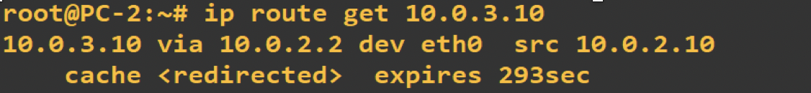
Routing Error: table manipulations with ICMP
when a router detects that an IP datagram should have gone to a different router, the router (here R2)
forwards the IP datagram to the correct router
sends an ICMP redirect message to the host
host uses ICMP message to update its forwarding cache not its forwarding table!!!
Routing Cache
R1

Slide 120
Chapter 4: outline
4.1 Overview of Network layer
data plane
control plane
4.2 What’s inside a router
4.3 IP: Internet Protocol
datagram format
fragmentation
IPv4 addressing
DHCP
IPv4 forwarding
ICMP
IPv6

Slide 121
IPv6: motivation
initial motivation: 32-bit address space soon to be completely allocated
additional motivation:
header format helps speed processing/forwarding
header changes to facilitate QoS
IPv6 datagram format:
fixed-length 40 byte header
no fragmentation allowed

Slide 122
IPv6 datagram format
priority: identify priority among datagrams in flow
flow label: identify datagrams in same “flow” (concept of“flow” not well defined)
next header: identify upper layer protocol for data
checksum, fragmentation: removed to reduce processing time at routers
ver
pri
flow label
payload len
next hdr
hop limit
source address
(128 bits)
destination address
(128 bits)
data
32 bits

Slide 123
Transition from IPv4 to IPv6
not all routers can be upgraded simultaneously
no “flag days”
how will network operate with mixed IPv4 and IPv6 routers?
tunneling: IPv6 datagram carried as payload in IPv4 datagram among IPv4 routers
IPv4 header fields
IPv6 header fields
IPv4 payload
IPv4 source, dest addr
IPv6 source dest addr
UDP/TCP payload
IPv6 datagram
IPv4 datagram

Slide 124
Tunneling
A
B
IPv4 tunnel
connecting IPv6 routers
E
F
logical view:
IPv6
IPv6
IPv6
IPv6
A
B
C
D
E
F
physical view:
IPv6
IPv6
IPv4
IPv4
IPv6
IPv6

Slide 125
Tunneling
A
B
IPv4 tunnel
connecting IPv6 routers
E
F
logical view:
IPv6
IPv6
IPv6
IPv6
A
B
C
D
E
F
physical view:
IPv6
IPv6
IPv4
IPv4
IPv6
IPv6
flow: X
src: A
dest: F
data
src:B
dest: E
src:B
dest: E
flow: X
src: A
dest: F
data
Flow: X
Src: A
Dest: F
data
Flow: X
Src: A
Dest: F
data
A-to-B:
IPv6
B-to-C:
IPv6 inside
IPv4
B-to-C:
IPv6 inside
IPv4
E-to-F:
IPv6

Slide 126
IPv6: adoption
Google: 8% of clients access services via IPv6
NIST: 1/3 of all US government domains are IPv6 capable
Long (long!) time for deployment, use
20 years and counting!
think of application-level changes in last 20 years: WWW, Facebook, streaming media, Skype, …
Why?

Slide 127
Chapter 4: outline
4.1 Overview of Network layer
data plane
control plane
4.2 What’s inside a router
4.3 IP: Internet Protocol
datagram format
fragmentation
IPv4 addressing
DHCP
IPv4 forwarding
ICMP
IPv6
NAT

Slide 128
Network Address Translation - NAT
Translation from internal, hidden, IP addresses to valid external Internet addresses.
Saves costs
Increases the number of available addresses
Secure – devices behind a firewall

Slide 129
Private Network
Private IP network is an IP network that is not accessible to the Internet. It is closed and self contained.
IP addresses in a private network can be assigned arbitrarily.
Not registered and not guaranteed to be globally unique
Generally, private networks use addresses from the following experimental address ranges (non-routable addresses):
10.0.0.0 – 10.255.255.255
172.16.0.0 – 172.31.255.255
192.168.0.0 – 192.168.255.255
Private networks can be connected to the Internet via a router but the devices are not directly accessible from the outside.

Slide 130
Private Networks and Addresses

Slide 131
Network Address Translation (NAT)
NAT is a method that enables hosts on private networks to communicate with hosts on the Internet
NAT is run on routers that connect private networks to the public Internet, to replace the IP address and (possibly) port# of an IP packet with another IP address-port pair at the boundary of a private network

Slide 132
Basic operation of NAT
Router IP address: 128.143.71.1
NAT device has address translation table
one to one address translation

Slide 133
Pooling of IP addresses
Scenario: Corporate network has many hosts but only a small number of public IP addresses
NAT solution:
Corporate network is managed with a private address space
NAT device, located at the boundary between the corporate network and the public Internet, manages a pool of public IP addresses
When a host from the corporate network sends an IP datagram to a host in the public Internet, the NAT device picks a public IP address from the address pool, and binds this address to the private address of the host

Slide 134
Pooling of IP addresses
Router accepts all addresses in pool:
128.143.71.0 – 128.143.71.30
128.143.71.21

Slide 135
Supporting migration between network service providers
Scenario: In CIDR, the IP addresses in a corporate network are obtained from the service provider. Changing the service provider requires changing all IP addresses in the network.
NAT solution:
Assign private addresses to the hosts of the corporate network
NAT device has static address translation entries which bind the private address of a host to the public address.
Migration to a new network service provider merely requires an update of the NAT device. The migration is not noticeable to the hosts on the network.
Note:
The difference to the use of NAT with IP address pooling is that the mapping of public and private IP addresses is static.

Slide 136
Supporting migration between network service providers

Slide 137
IP Masquerading – Most Common NAT
Also called: Network address and port translation (NAPT), port address translation (PAT).
Scenario: Single public IP address is mapped to multiple hosts in a private network.
NAT solution:
Assign private addresses to the hosts of the corporate network
NAT device modifies the port numbers for outgoing traffic

Slide 138
IP Masquerading

Slide 139
NAT: network address translation
NAT translation table
WAN side addr LAN side addr
2: NAT router
changes datagram
source addr from
10.0.0.1, 3345 to
138.76.29.7, 5001,
updates table
1: host 10.0.0.1
sends datagram to
128.119.40.186, 80
138.76.29.7, 5001 10.0.0.1, 3345
…… ……
S: 10.0.0.1, 3345
D: 128.119.40.186, 80
10.0.0.1
1
2
S: 138.76.29.7, 5001
D: 128.119.40.186, 80
10.0.0.4
10.0.0.2
138.76.29.7
S: 128.119.40.186, 80
D: 10.0.0.1, 3345
4
S: 128.119.40.186, 80
D: 138.76.29.7, 5001
3
10.0.0.3
4: NAT router
changes datagram
dest addr from
138.76.29.7, 5001 to 10.0.0.1, 3345
3: reply arrives
dest. address:
138.76.29.7, 5001
* Check out the online interactive exercises for more examples: http://gaia.cs.umass.edu/kurose_ross/interactive/

Slide 140
Load balancing of servers
Scenario: Balance the load on a set of identical servers, which are accessible from a single IP address
NAT solution:
Here, the servers are assigned private addresses
NAT device acts as a proxy for requests to the server from the public network
The NAT device changes the destination IP address of arriving packets to one of the private addresses of a server
A sensible strategy for balancing the load of the servers is to assign the addresses of the servers in a round-robin fashion.

Slide 141
Load balancing of servers
This is a situation where one public address is shared by several machines
inside a private network for the sole purpose of load balancing.
Public Source
Address
Source: 213.168.12.3
Destination: 10.0.1.4
Here we see that IP address 128.143.71.21 is shared by several machines.
The NAT device uses a round robin technique to distribute the incoming requests to the servers.
The source addresses of incoming requests are used to distinguish between the traffic streams connected to the internal servers.

Slide 142
NAT: Public Services and P2P
NAT does not allow outside (public) access to any machine behind the NAT device if there is NO unique public IP address associated (directly mapped) with a specific internal IP address.
In other words, it can route traffic that is addressed to a device behind a NAT device ONLY if it has a public IP address allocated to it (i.e., mapped to its internal address).
Services such as Web hosting, FTP, can be addressed by the one to one mapping of a specific IP address.
P2P services (Skype, Spotify, etc.) cannot be hosted unless a specific server called a moderator/tracker/relay is used to serve as a go between.

Slide 143
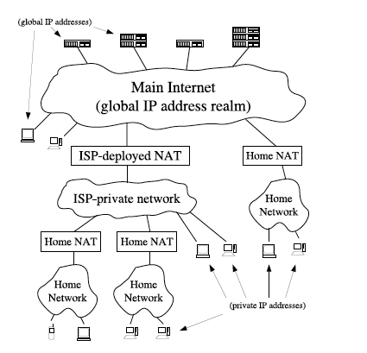
Possible NAT Scenarios
Three possible scenarios:
Two clients reside behind the same NAT, on one private network
The clients reside behind different NATs, different private networks
The clients each reside behind two levels of NAT: a common “first-level”NAT deployed by an ISP for example, and distinct “second-level” NATs such as consumer NAT routers for home networks

Slide 144
Hole Punching: UDP and TCP
one of the most effective methods of establishing peer-to-peer communication between hosts on different private networks is known as “hole punching.”
hole punching enables applications to function within the default security policy of most NATs, effectively signaling to NATs on the path that peer-to-peer communication sessions are “solicited” and thus should be accepted.
unfortunately, no traversal technique works with all existing NATs, because NAT behavior is not standardized.
we will focus on the simplest hole punching technique that works cleanly and robustly in the presence of “well-behaved” NATs in any reasonable network topology.

Slide 145
NAT Terminology
The notion of session:
“A session endpoint for TCP or UDP is an (IP address, port number) pair, and a particular session is uniquely identified by its two session endpoints.”
From the perspective of a host, a session is effectively identified by the 4-tuple (local IP, local port, remote IP, remote port).
The direction of a session is normally direction of the first packet that initiates the session: i.e., the initial SYN packet for TCP, or the first user datagram for UDP.
The most common type of NAT is traditional or outbound NAT, which provides an asymmetric bridge between a private network and a public network.
Outbound NAT has two sub-varieties: Basic NAT, which only translates IP addresses, and Network Address/Port Translation (NAPT), which translates entire session endpoints.
Hole punching uses NAPT.

Slide 146
Understanding the Problem
The key to the NAT puzzle lies in making machines behind a NAT gateway reachable from the outside, (i.e., the public Internet).
To do that, an application has to force a host behind the NAT to initiate a connection to a host outside, that is seeking to connect to the internal host.
NAT devices allow inbound traffic, i.e., replies to requests originating from behind the NAT device.
So instead of connecting directly to the host behind NAT (impossible), we need to mimic a scenario in which the target host originates a connection to the outside host by responding to the request. In other words, the connection request to the target host should seem like a reply to the NAT device. “Connection Reversal”

Slide 147
Approach
First is the issue of how to get the private host to send a request so we can send a “connection request” to it that is masquerading as a reply.
But, NAT devices (routers) also have an idle timer, typically of around 60 seconds, they stop waiting for replies once a request originates and no reply comes within 60 seconds. So, it is not enough that the private host originate traffic, but also we have to act fast—we have to send the “reply” before the NAT device (router) removes the “association” with the private host, which will frustrate the connection attempt.

Slide 148
Traversal By Connection Reversal Using a Server – Public to Private
Going from a host/peer on the public IP internet to a host/peer on a private network with no dedicated public IP address.
Use a “rendezvous” server, listening on a global IP address through a persistent TCP or UDP connection.
If A on a private network wants to initiate a connection to B on a public network, then a direct connection attempt works automatically, because B is not behind a NAT and A’s NAT interprets the connection as an outgoing session.
If B wants to initiate a connection to A, however, any direct connection attempt to A is will not be routed by the Internet as A does not have a valid IP address.
B can instead relay a connection request to A through a well-known server S, asking A to attempt a “reverse” connection back to B.

Slide 149
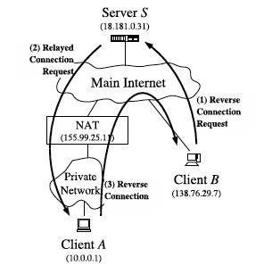
Connection Reversal
Public to Private

Slide 150
Relaying Using an Intermediate Server – P2P both behind NAT
Relaying - A reliable, but least efficient method for P2P communication across NAT is simply to make the communication look to the network like standard client/server communication, through relaying.
Two client hosts, A and B, each initiate TCP or UDP connections to a well-known “rendezvous” server S, at S’s public IP address YY and a predetermined port number XX.
The two clients simply use the server S to relay messages between them along along their already-established client/server connections, and server S forwards the messages.
Connections (TCP and UDP) have to be persistent. NAT times out UDP NAPT connections, so it has to happen fast or host has to continue sending “keep alive” UDP packets to the server to maintain the connection. TCP session has to be kept alive too.

Slide 151
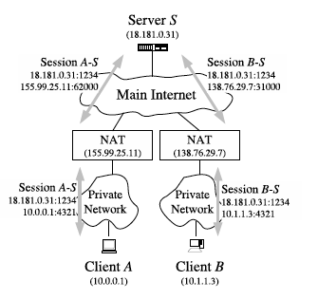
Relaying with a Server

Slide 152
UDP Hole Punching - Basic Idea
UDP hole punching enables two clients to set up a direct P2P UDP session with the help of a well-known “rendezvous” server, even if the clients are both behind NATs.
Rendezvous - eliminates the “Server” function after connection setup.
Hole punching assumes that the two clients, A and B, already have active UDP sessions with a “rendezvous” server S.
When a client registers with S, the server records two endpoints for that client: the (IP address, UDP port) pair that the client is using to talk with S, and the (IP address, UDP port) pair that the server observes the client to be using to talk with it. (private pair and public pair)
We refer to the first pair as the client’s private endpoint and the second as the client’s public endpoint.
HOW???

Slide 153
Relaying
Public
End Point
Private
End Point

Slide 154
Obtaining the Clients’ Private and Public Addresses
The server will obtain:
the client’s private endpoint from the client itself in a field in the body of the client’s registration message, and
obtain the client’s public endpoint from the source IP address and source UDP port from the in the IP and UDP headers of the registration message.

Slide 155
Establishing P2P Sessions
A initially does not know how to reach B, so A asks S for help establishing a UDP session with B.
S replies to A with a message containing B’s public and private endpoints. At the same time, S uses its UDP session with B to send B a connection request message containing A’s public and private endpoints. Once these messages are received, A and B know each other’s public and private endpoints.
When A receives B’s public and private endpoints from S, A starts sending UDP packets to both of these endpoints, and subsequently “locks in” whichever endpoint first elicits a valid response from B. ?????
Similarly, when B receives A’s public and private endpoints in the forwarded connection request, B starts sending UDP packets to A at each of A’s known endpoints, locking in the first endpoint that works. ?????
The order and timing of these messages are not critical as long as they are asynchronous.
If both A and B are on the same NAT device the private endpoints will work. If they are not, then only the public endpoints will work to connect.

Slide 156
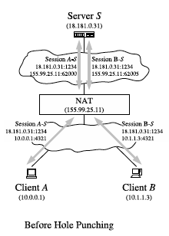
Hole Punching: Same NAT

Slide 157
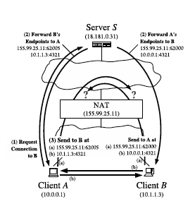
Hole Punching Process

Slide 158
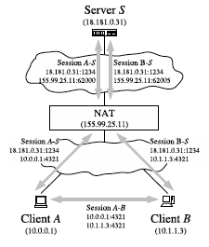
After Hole Punching

Slide 159
Hole Punching: Different NATs
Public
Private
Session A-B
155.99.25.11:6200
138.76.29.7:31000

Slide 160
Hole Punching Scenarios
Three possible scenarios:
Two clients reside behind the same NAT, on one private network
The clients reside behind different NATs, different private networks
The clients each reside behind two levels of NAT: a common “first-level”NAT deployed by an ISP for example, and distinct “second-level” NATs such as consumer NAT routers for home networks
It is in general difficult or impossible for the application itself to determine the exact physical layout of the network, and thus which of these scenarios (or the many other possible ones) actually applies at a given time.
Nevertheless, hole punching works automatically in all of these scenarios without the application having to know the specific network organization, as long as the NAT routers involved behave in a “reasonable” fashion, i.e., don’t overwrite IP addresses and port numbers in bodies of messages (i.e., registration messages).
Why? Because some apps embed IP addresses in the data, and to work properly the NAT needs to change the private address to the public one in the body of the message. In that case it wont work. So it depends on how the NAT is setup.

Slide 161
NAT:Pros
local network uses just one IP address as far as outside world is concerned:
range of addresses not needed from ISP: just one IP address for all devices
can change addresses of devices in local network without notifying outside world
can change ISP without changing addresses of devices in local network
devices inside local net not explicitly addressable, visible by outside world (a security plus)

Slide 162
NAT: Cons
16-bit port-number field:
60,000 simultaneous connections with a single LAN-side address!
NAT is controversial:
routers should only process up to layer 3
address shortage should be solved: -> IPv6
violates end-to-end argument
NAT existence and usage must be taken into account by app designers, e.g., P2P applications
NAT traversal: what if client wants to connect to server behind NAT?

